Slide 1
Voice based mail assistant

Slide 2
Contents
Abstract
Introduction
Existing system
Disadvantages
Proposal
Advantages
Hardware and software requirements
List of modules
Module description
System design
Screenshots
Conclusion

Slide 3
Abstract
Voice based Mail system architecture is an application software which can be used by a Blind person to access Mails easily and efficiently. The developed application is interactive and it is user friendly and is efficient in accessing mail. The developed software also provides scope for several other operations like Wikipedia search, weather information. we can also shut down our pc through voice commands.
The user only needs to speak the predefined keywords for each action to take place such as Login, Send, group mail etc. In this way it will become very easy to access mails for those who cannot see. So, the need to rely on other people for using mail will be reduced. The complete system is based on SIT (Speech to text), TTS (Text to Speech), IVR (interactive voice response). The application will detect the voice commands of user and responds accordingly.

Slide 4
Introduction to title
The internet communication technology provides us the opportunity to keep in touch with the world through emails, video conferencing, instant messaging and more. But the blinds cannot use these facilities efficiently because all this requires visual perception.
This project introduces an application that can be mainly used by blind people to access Mails through voice, Many other web Applications run on voice commands.

Slide 5
Existing System
As Blind people cannot visualize what is already present on screen they cannot make out where to click in order to perform the required operations like sending mail, reading time, browsing internet, shutting down the system etc.

Slide 6
Disadvantages of existing System
We can use the mail service with ease.
blind people can not operate hassle free.
It is not accurate and efficient to the blind people.
It is inconvenient.

Slide 7
Proposal
The most important aspect that has been kept in mind while developing the proposed system is accessibility.
A web system is said to be perfectly accessible only if it can be used efficiently by all types of people whether able or disable(blind people).
All operations will be based on voice commands.

Slide 8
Advantages of Proposal
One of the major advantages of this system is that user won’t require to use the keyboard.
We can use the mail service with ease.
Disabled people could operate hassle free.
It is accurate and highly efficient.

Slide 9
system Requirements
The basic hardware required to run the program are:
Hard disk of 20 GB
System memory (RAM) of 4GB
I3 processor-based computer or higher
The basic software required to run the program are:
Python
smtplib

Slide 10
List of Modules
Speech to Text
Text to Speech.
Interactive voice response.

Slide 11
Speech to Text
By using Speech Recognition.
Speech Recognition :- Library for performing speech recognition, with support for several engines and APIs, online and offline.

Slide 12
Text TO Speech
By using Pyttxs3.
Pyttsx3 :- pyttsx3 is a text-to-speech conversion library in Python. Unlike alternative libraries, it works offline, and is compatible with both Python 2 and 3.

Slide 13
Interactive voice response
By using PyAudio.
PyAudio :- PyAudio provides Python bindings for PortAudio, the cross-platform audio I/O library.

Slide 14
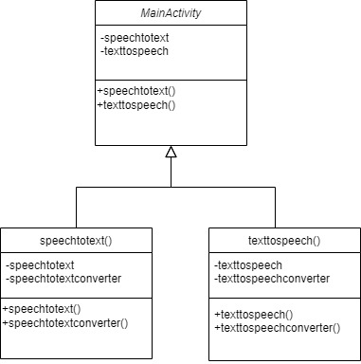
Class diagram

Slide 15
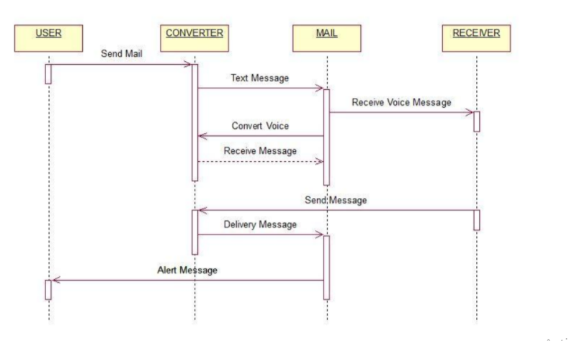
Sequence diagram

Slide 16
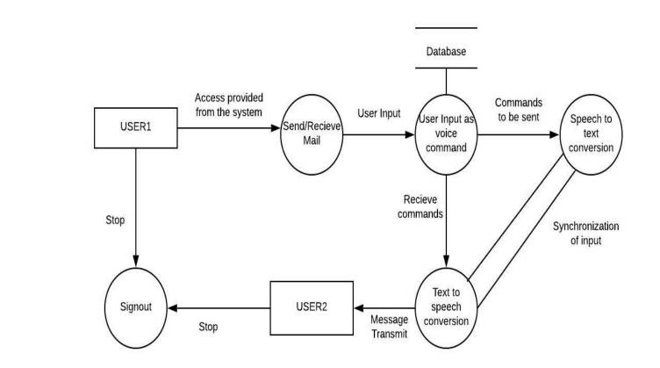
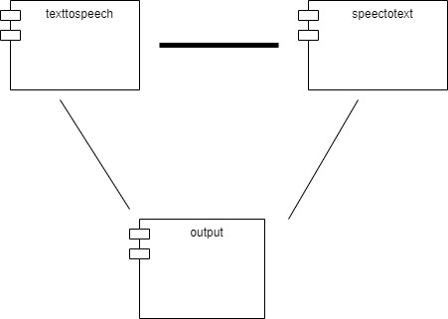
Data flow diagram
Component diagram

Slide 17
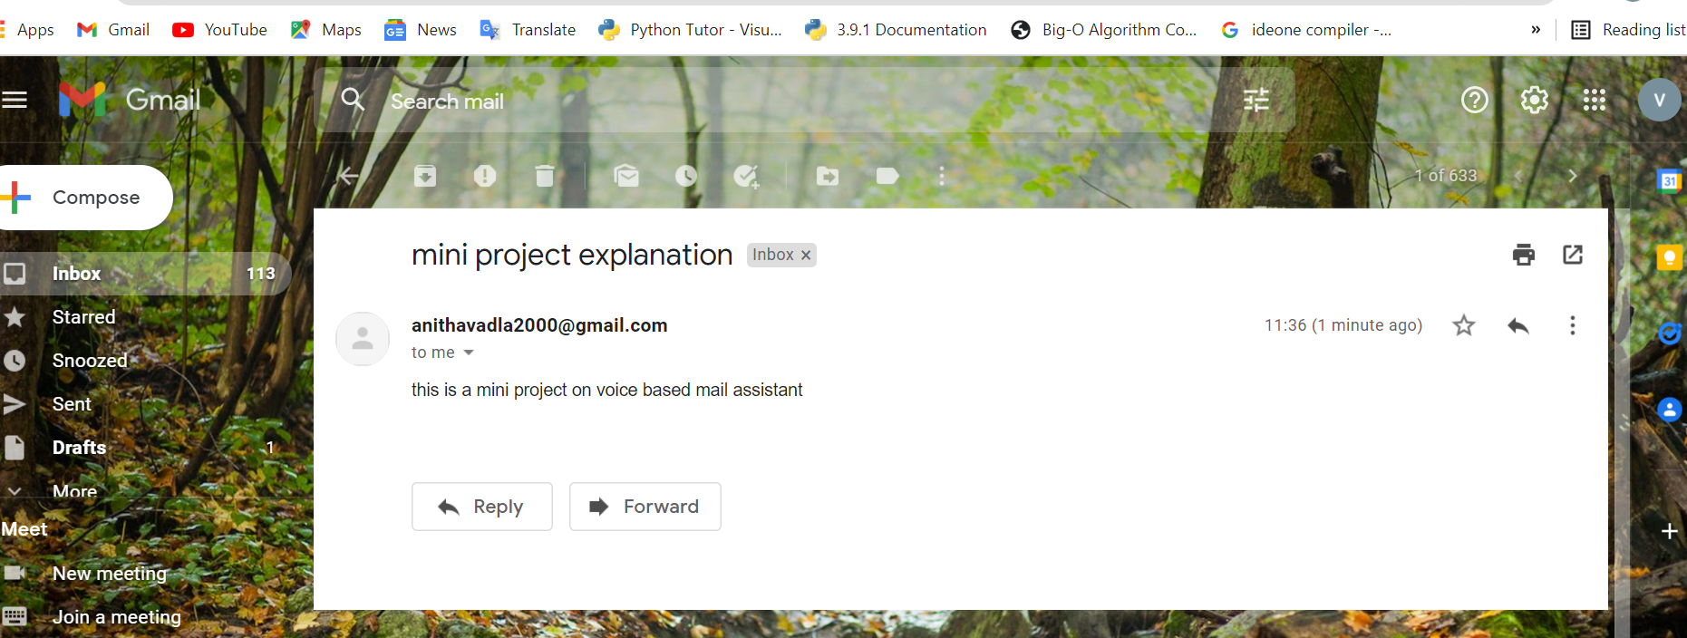
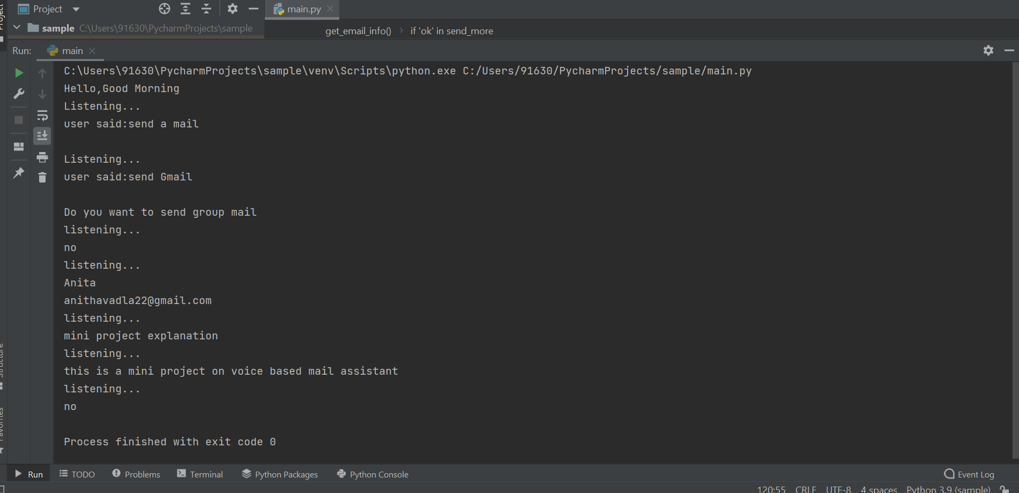
Screenshots of gmail

Slide 18
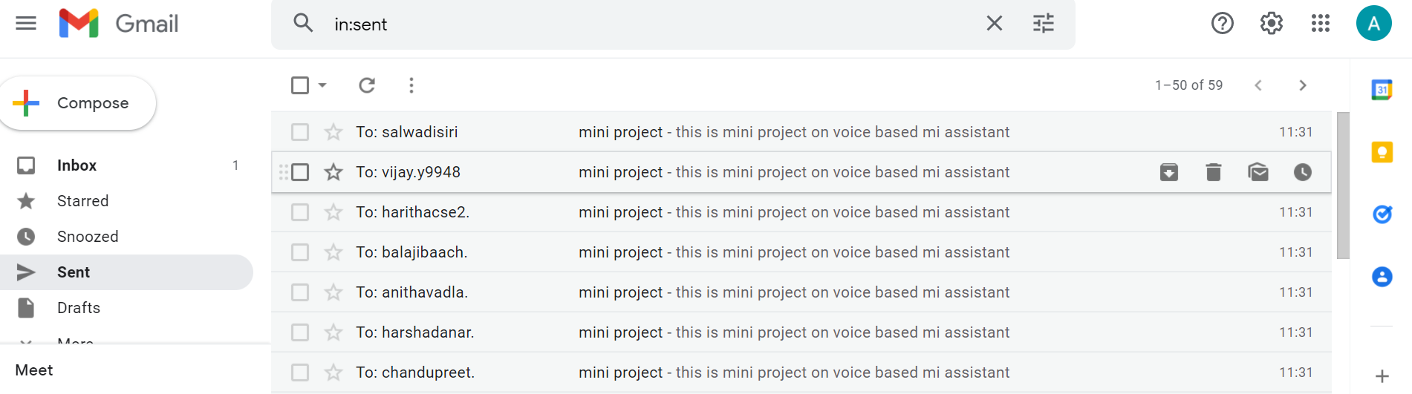
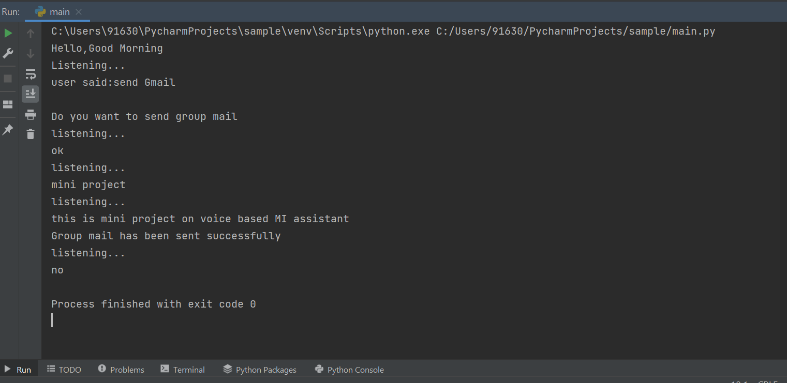
Screenshot of groupmail

Slide 19
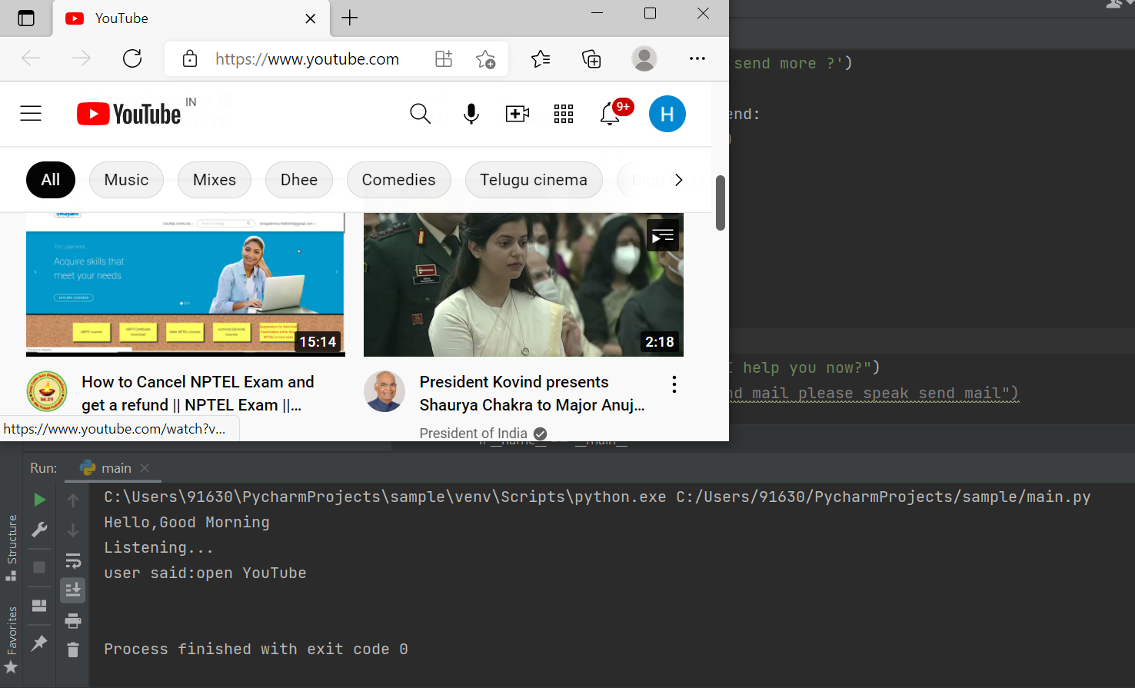
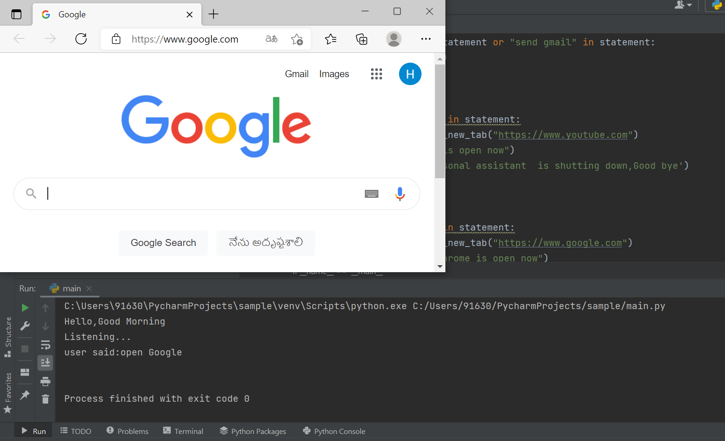
Screenshot of open google
Screenshot of open youtube

Slide 20
conclusion
This voice based mail system is very effective and helpful for the visually impaired people. This system has the feature of speech to text and text to speech with speech reader which is useful for blind people as well as visually impaired person.
The application will detect the voice commands of user and with the help of interactive voice response user can interact with the application easily and efficiently.

Slide 21
Thank You

